Slide 1
GMC FtP and My Trainee
Educational Supervisors Update Day 13th October 2022
Katie Laugharne GMC Wales Employer Liaison Adviser

Slide 2


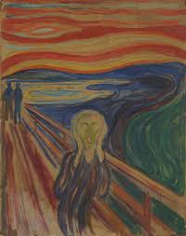
Today’s session
FtP facts and figures
Thresholds
Implications for you and your trainee
Q&A

Slide 3
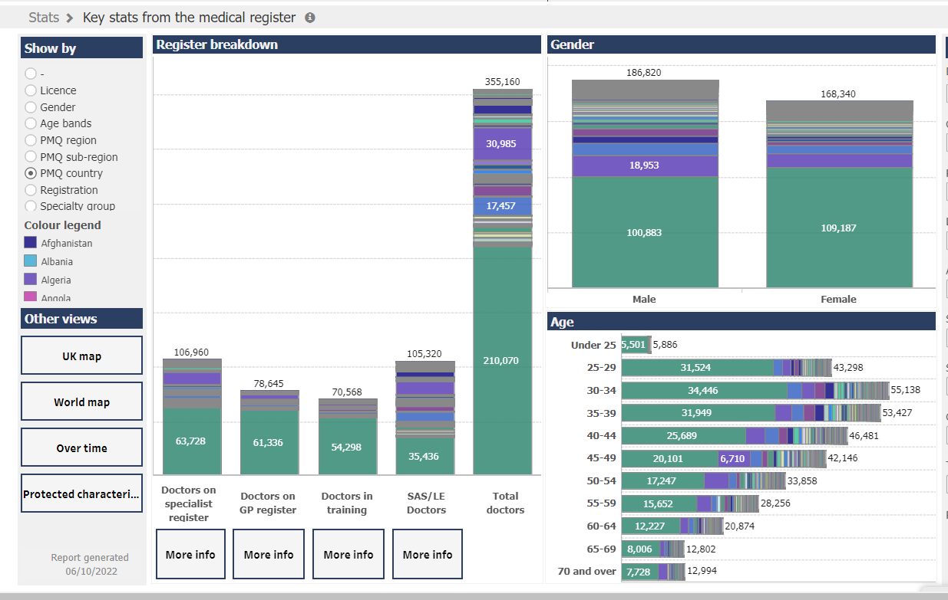
Facts and figures: The register
https://data.gmc-uk.org/gmcdata/home/#/reports/The Register/Stats/report
Notes:
Data Explorer provides a huge range of reports based on our register and is publicly available
These are our current UK registration figures
I have filtered this data by place of primary medical qualification
In this screen the register is filtered by country of PMQ with the dark green being UK, you can also see the gender and age breakdowns

Slide 4
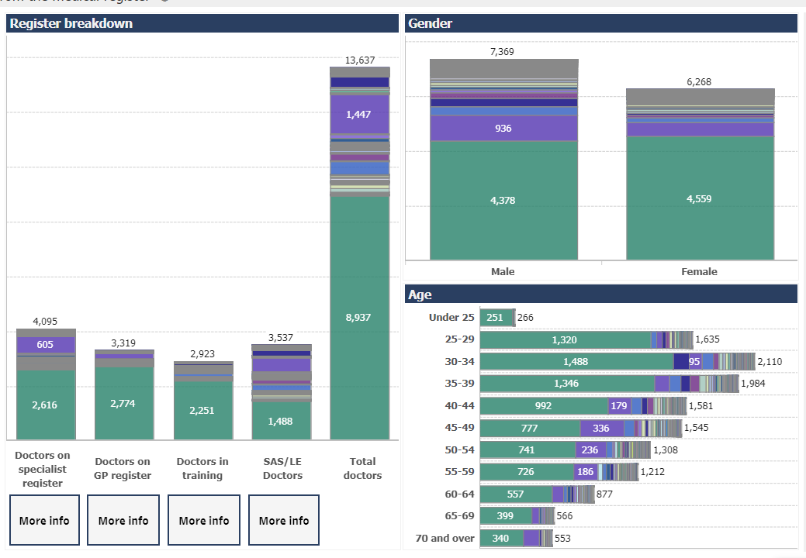
The profile of the register in Wales
Notes:
This is the same data for Wales – 2,823 doctors in training of which 2,251 currently have a PMQ from the UK

Slide 5
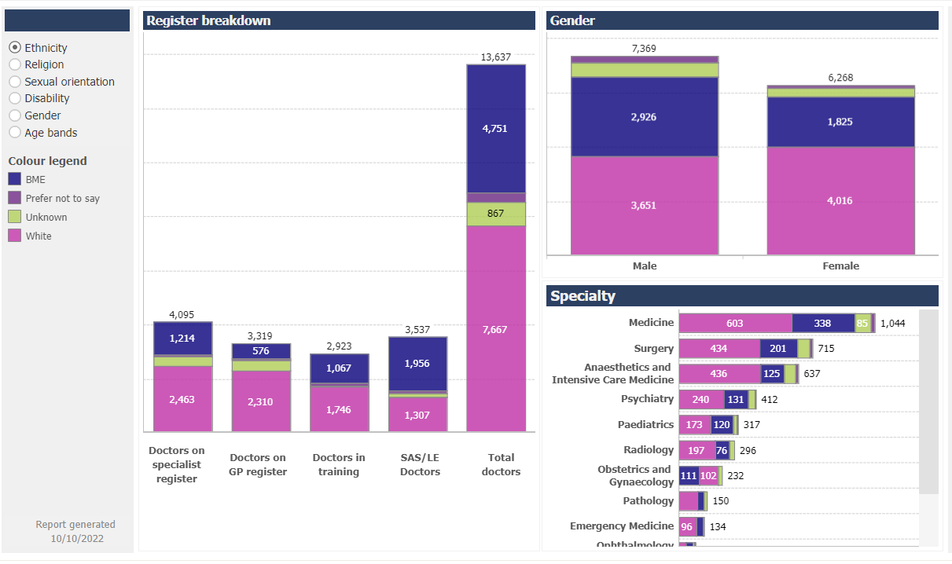
The profile of your trainees: ethnicity
Notes:
This screen shows the same data but broken down by ethnicity, with the pink being white.
Just over half of the doctors in training cohort have identified as ‘white’, with the proportions varying by gender and by specialty. You can see for anaesthetics and intensive care medicine around 2/3 of your trainees identify as white.

Slide 6
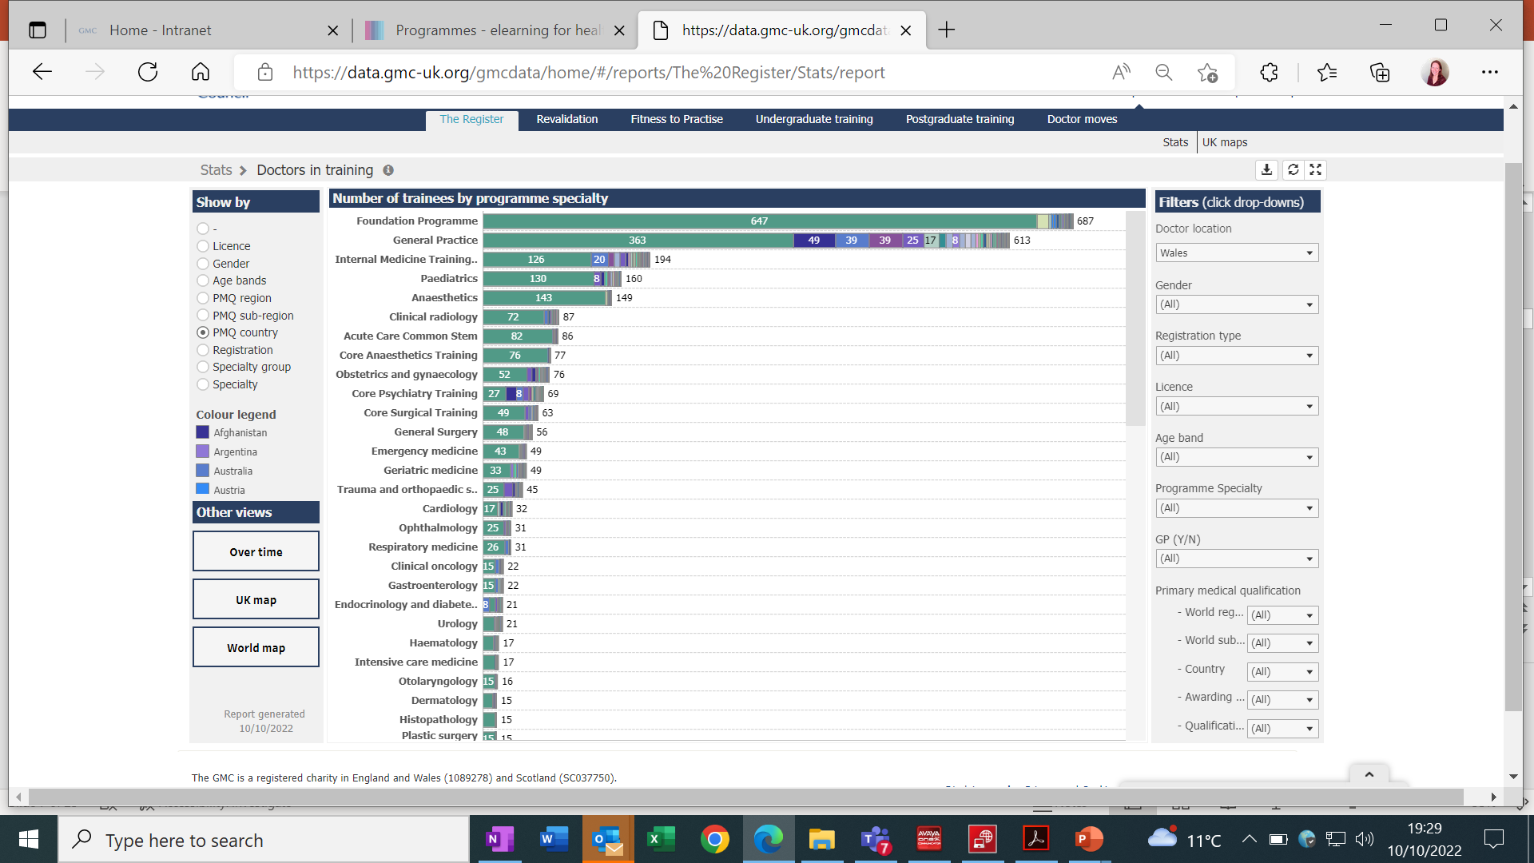
The profile of your trainees: by PMQ and programme specialty
Notes:
Here’s the more detailed breakdown for Wales, going back to PMQ. Interestingly the different specialities have different profiles in terms of PMQ. Looking at your programmes for example, 143 out of your 149 anaesthetics trainees have a UK PMQ and the profile is similar for intensive care medicine. However looking at some of the other specialities just over half of GP trainees have a UK PMQ, and less than half of core psychiatry trainees. This obviously has implications in terms of induction and ongoing support.

Slide 7
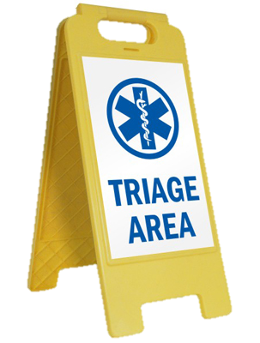

FtP: 2021 figures: How many…
Complaints and referrals
Investigations
Referred to MPTS
Suspensions
Erasures
Notes:
Moving on to talk specifically about FtP. You will remember we now have 350,000 doctors on the UK register. Given that…
In 2021 we received 9,074 concerns about doctors. This is a slight increase on 2020 but is in line with our annual average.
75% of these were raised by members of the public
All concerns are considered by our triage teams… we only investigate when these raise issues about a doctor’s ability to practise safely or threaten public confidence in the profession.
We also have a new process called Provisional Enquiries… includes consideration of single clinical incidents
After these processes, only 10% (925) went on to a full investigation. Interestingly, only 9% of these were complaints from the public, whereas 77% were referrals form employers. We don’t usually notify doctors that we have received a complaint about them unless it goes on to a full investigation – so no dreaded letter at this stage. This is to avoid the unnecessary stress as so many of these complaints are closed at triage.

Slide 8
FtP: 2021 Figures
Triage & Provisional Enquiries
9,074 complaints
925 investigations
269 to MPTS
91 suspensions
58 erasures
2 x Case Examiners
Collection of information
MPTS panel
Interim Orders Tribunal Panel

Slide 9

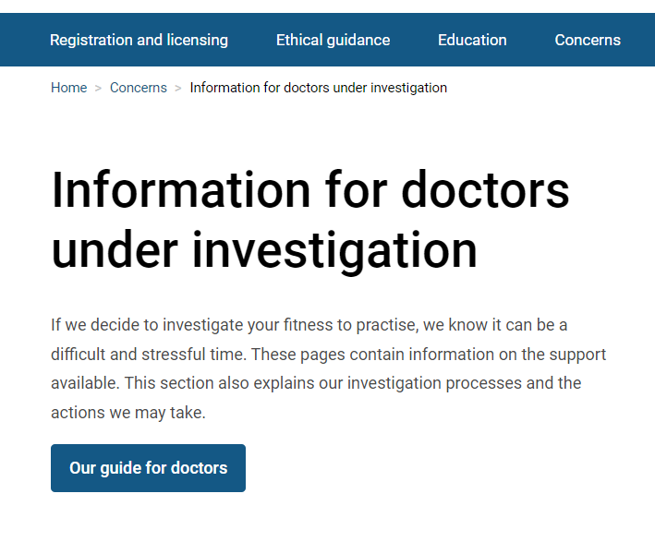
Supporting doctors under investigation
Free, independent confidential emotional support
For any doctor under investigation
Includes support at meetings with GMC or hearing
Provided by doctors
https://www.gmc-uk.org/concerns/information-for-doctors-under-investigation/support-for-doctors
Notes:
We recognise that going through an investigation is extremely stressful. At the best of times it can also be lengthy, and there have been delays to many of our processes due to the pandemic.
In recognition of this we fund this support service for doctors who are under investigation, which is provided through the BMA. We also provide lots of information online about the investigation process and highlight other sources of support provided nationally.

Slide 10





Principles of FtP
To protect and maintain standards, patient safety and public confidence in the profession
Focus is on current impairment
Balancing assessment of risk and local assurances / mitigations
‘Ideally, concerns will be dealt with locally; a referral can be made at any point if there is an immediate or serious potential risk to patient safety or public confidence in the profession’

Slide 11

FtP Thresholds
What kinds of things do you think we consider, when assessing whether a threshold for referral is met?
Example:
Is there a serious, or persistent, breach of Good Medical Practice?
Notes:
Thresholds are very important to us in terms of FtP as we only want to open an investigation in the cases which present a real and serious risk to patient safety, and in which FtP is likely to be impaired. My conversations with ROs are often about thresholds – does this meet the threshold for UPSW, for local restrictions, for referral to the GMC.
Take a few minutes just to discuss with the person or people nearest to you
We’re thinking about the broad issues, or questions we might ask ourselves / ask you
Anyone like to call out a suggestion?

Slide 12
GMC Thresholds: some considerations
Serious or persistent breach of GMP?
Immediate or serious risk to patient safety / public confidence, to colleagues or to the doctor?
Are local restrictions, including support and supervision, sufficient to mitigate the risks?
Violence?
Inappropriate sexual behaviour?
Dishonesty, fraud?
Improper relationship with a patient
Context, environmental factors
Existing / ongoing process? (UPSW, police etc)
Ongoing attempts at remediation?
Is the doctor engaging with attempts to resolve?
Does the doctor work elsewhere?
Has the doctor left / resigned / changed connection?
Self-referral? (GMP para 75)
Health?
Has the doctor raised Public Interest Concerns?
GMC Thresholds guidance
Notes:
75. You must tell us without delay if, anywhere in the world:
You have accepted a caution from the police or been criticised by an official inquiry
You have been charged with or found guilty of a criminal offence
Another professional body has made a finding against your registration as a result of fitness to practise procedures.
There is a bit more info on all of these at the end of the slidepack, fyi We will usually only need to investigate on the basis of health if the doctor’s health is compromising patient safety

Slide 13
Thresholds - Scenarios
Can you think of one or more examples for each of these categories?
What are your responsibilities?
What do you need:
To consider?
To find out?
To share with others?
To seek advice on?
What would prompt you to escalate?
Managed and supported by you
Involve local systems (HB, HEIW, NWSSP etc)
Consider referral to GMC
Notes:
Thresholds will tend to indicate one of these three categories – although noting there are lots of cases where it is not clear, or more information is needed in order to make that assessment

Slide 14
Managed by you
Local systems (HB, HEIW, NWSSP etc)
Consider referral to GMC
Scenarios
Dr A advises you that they have been convicted of drink driving
Dr B admits to self-prescribing, stating that they needed something to manage their anxiety and to help them sleep
Dr C is struggling with a specific procedure. Additional support and supervision is being provided
Dr D has been arrested on suspicion of stalking but released, investigation is ongoing
Complaints have been made about Dr E’s attitude to members of the team including nurses and physios. These include allegations that Dr E is rude and dismissive
Notes:
(check time)

Slide 15
Scenarios
Dr F’s documentation does not meet the required standard. Dr F has received additional support and guidance but things have not improved. A suggestion has been made that Dr F has changed some of their notes after the event without documenting this
Dr G has allegedly asked two nurses to sign off a procedure which they did not complete. It has also been suggested that Dr G is undertaking paid locum shifts during protected training time
Multiple complaints have been received that Dr H behaves inappropriately with colleagues, including touching their arms and hands in a way that makes them feel uncomfortable; making inappropriate innuendos; telling lewd jokes; repeatedly asking for their numbers and asking to meet up after work despite having been told they do not want to do so

Slide 16

Additional considerations: disproportionate referrals
In 2019 we commissioned a UK-wide review, ‘Fair to Refer?’
This showed that BME Doctors are twice as likely to be referred to the GMC by their employer than white doctors.
Non-UK doctors have a 2.5 times higher referral rate from their employer than doctors who graduated within the UK.
Employer referrals are significantly more likely to result in an investigation.

Slide 17
Key findings and recommendations
Fair to Refer
Induction & support
Professional isolation
Inaccessible leadership
Lack of effective feedback
Insider / outsider dynamics
Focus on blame not learning
Recommendations:
UK wide framework for induction, support and feedback
Support a just culture
Support leaders to create positive, inclusive working environments
Notes:
These were the factors highlighted in the report which were seen to contribute to the disproportionate referrals. We are trying to influence and support in all these areas, notably supporting induction via HEIW and HBs; continuing our work looking at fairer feedback; contributing to the rollout of compassionate leadership

Slide 18
Additional considerations for you and your trainee
GMC standards, processes and thresholds apply in the same way for trainees
Context is everything – especially for training
What level of supervision and support has been / can be provided?
Has there been appropriate induction, assimilation, feedback, peer support, inclusion etc…
Training progression vs fitness to practice
What can appropriately be remediated / managed through training? What are the residual concerns?
Additional complexities of multiple roles and information sharing - RO (HEIW), Single Lead Employer (NWSSP) and host organisation; Foundation trainees;
Who is responsible for what? What is your role?

Slide 19


Reflections and questions

Slide 20
Thank You
Katie.Laugharne@gmc-uk.org
https://www.gmc-uk.org/

Slide 21
Additional information
Some further information, FYI

Slide 22
Thresholds: Self-referral
75: You must tell us without delay if, anywhere in the world:
You have accepted a caution from the police or been criticised by an official inquiry
You have been charged with or found guilty of a criminal offence
Another professional body has made a finding against your registration as a result of fitness to practise procedures.
76: If you are suspended by an organisation from a medical post, or have restrictions placed on your practice, you must, without delay, inform any other organisations you carry out medical work for and any patients you see independently.
Good Medical Practice Domain 4 - Maintaining trust - GMC (gmc-uk.org)
Notes:
In terms of self-referrals, these are the instances listed in Good Medical Practice which you MUST tell us about. Official inquiries include coroner and ombudsman reports.

Slide 23
Thresholds for referral: Guidance
Ideally, concerns will be dealt with locally; a referral can be made at any point if there is an immediate or serious potential risk to patient safety or public confidence in the profession
Conduct or performance falls below the standard set out in GMP… attempts to improve the doctor’s performance locally have failed… there remains an unacceptable risk to patient safety despite safeguards put in place
Local measures to address the concerns have failed either because the doctor is not complying with them or the concerns are too significant to be remediated at a local level
GMC Thresholds guidance

Slide 24
Thresholds for referral: Guidance (cont)
Deliberate or reckless disregard of clinical responsibilities
Abuse of a patient’s trust or violation of a patient’s autonomy
Behaviour that is dishonest, fraudulent or is designed to mislead or harm others
Behaviour was such that public confidence in doctors generally might be undermined if we did not take action
When a doctor’s health is compromising patient safety. There is no need for us to intervene if there is no risk to patients or to public confidence.
Notes:
Paragraph 19 at http://www.gmc-uk.org/Guidance_GMC_Thresholds.pdf_48163325.pdf

Slide 25
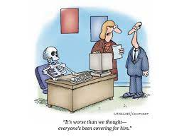
Thresholds: health
If you can manage your own health condition effectively, there’s no need for us to get involved
If you have a health condition or a problem with alcohol or drugs that may put patients at risk, you need to tell us so we can make sure patients are protected
https://www.gmc-uk.org/concerns/information-for-doctors-under-investigation/support-for-doctors/managing-your-health
Notes:
Doctors are often concerned about whether or not they need to let us know about a health condition.
If you have a health problem you can manage and still maintain a good level of care for your patients, there's no need for us to get involved.
If you've been referred to us for health concerns or have told us yourself, because you feel this may put yourself or your patients at risk, we may decide to investigate. We'll deal with this as sensitively as we can. If we feel that the concerns raised about your health condition could put patients at risk, we may ask you to have a health assessment.

Slide 26
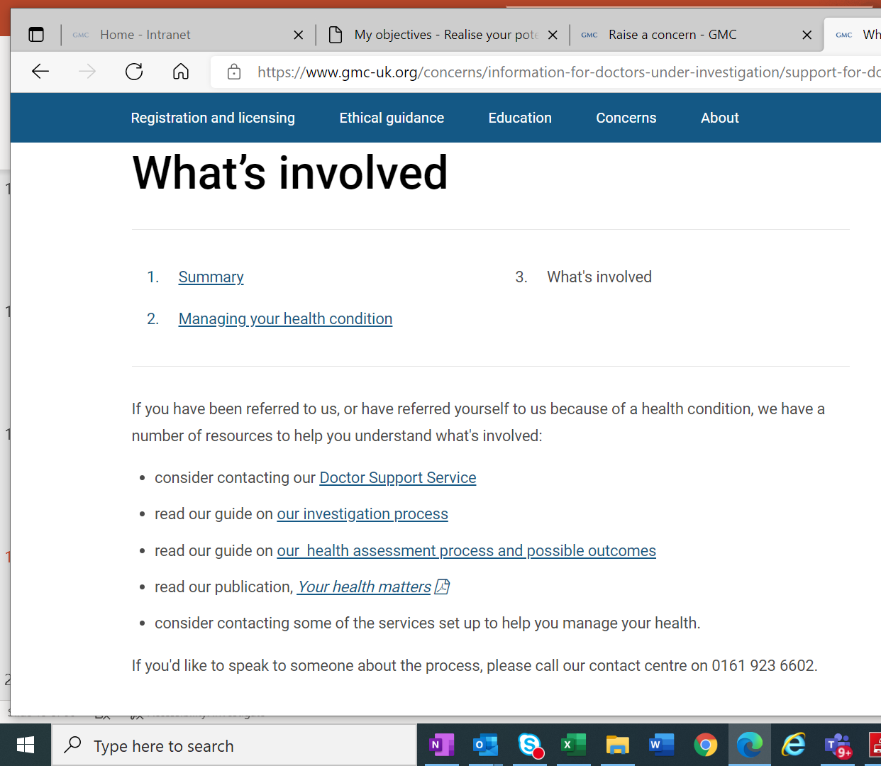
Health assessments
Health concerns may be identified via:
Self-referral
Referral
Emerge during an investigation
Case Examiners can decide to direct a Health Assessment
‘It’s important that you take a health assessment if we ask you to. If you don’t, we may refer you directly to a tribunal hearing at the MPTS.’
A health assessment is one part of a wider investigation into your fitness to practise. It will help us to understand any health concerns before considering whether we need to take any measures to protect patients.
We'll select two doctors to carry out an examination of your physical and/or mental health.
https://www.gmc-uk.org/concerns/information-for-doctors-under-investigation/health-assessments
Notes:
Referral for health likely to be necessary if:
significant concerns arise about patient safety, for example, where a doctor’s ill-health (including addiction) appears to be uncontrolled or where there is evidence that the doctor is not following advice
if there is a significant risk of relapse or loss of insight, which may be characteristic of a condition, for example, addiction or certain mental health conditions
in respect of significant misconduct issues, for example, where a doctor is convicted of a drink-driving offence.

Slide 27
Health assessment outcomes
We will usually offer undertakings, if the only concerns about your practice are a result of a health condition. We can protect patient safety through an agreement with you.
In this case, you will enter into our monitoring process.
You will be assigned a GMC Medical Supervisor
Regular review and support
Point of contact with GMC and employer
Information about your health, including any relevant undertakings or conditions is confidential.
We won't disclose it to your employer, workplace supervisor or responsible officer without discussing it with you.
We will only publish and disclose non health-related undertakings and conditions that relate to your practice.

Slide 28
At the end of an investigation
Possible outcomes:
Conclude with No Further Action
Issue advice
Agree undertakings
Issue a warning
Possible outcomes:
Refer to a Medical Practitioners Tribunal Service (MPTS) panel
What types of cases are most likely to be referred to MPTS?
Notes:
At the end of an investigation, 2 Case Examiners – 1 lay and 1 medical – will consider all the information and decide on the next steps. These are all the possible outcomes.
Which outcome do you think is the most common? (NFA – 60%)
Second? (MPTS – 30%)
NB the MPTS is separate to the GMC. GMC undertakes the investigations and refers the most serious cases to MPTS. MPTS makes a decision about the facts and about impairment, and then decides on the appropriate sanction. (like the police and the CPS)
In 2021, around 60% of cases concluded with no further action while 30% were referred to MPTS for a hearing.
Outcomes of case examiner decisions in 2021 (925 investigations):
Concluded with no further action - 569 (62%)
Issued advice – 51
Doctors agreed undertaking – 67
Issued a warning – 87
Referred to MPTS – 269 (30%)

Slide 29
Types of cases most likely to be referred to MPTS
Sexual assault or indecency
Violence
Improper sexual or emotional relationship with a patient or someone close to them
Dishonesty
Knowingly practising without a licence
Notes:
In 2021, of the 269 cases concluded at the Medical Practitioners Tribunal Service (MPTS) only five related to purely issues of performance.
⚫ Other cases included criminal conviction, misconduct, dishonesty or health issues impacting on the doctor’s performance and fitness to practice

Slide 30
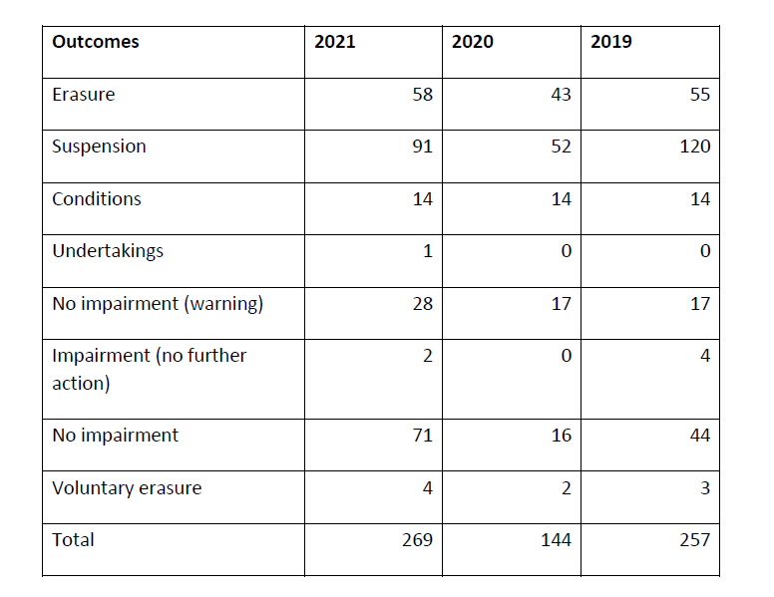
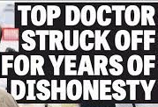
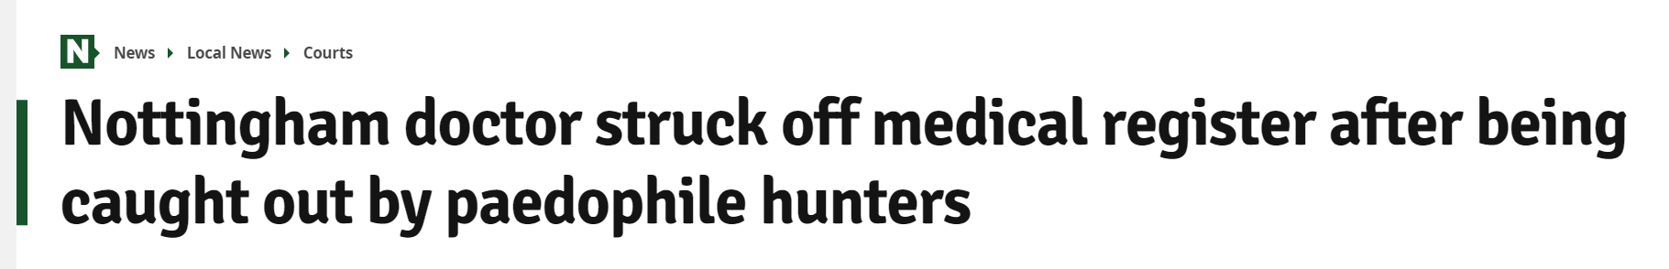
Outcomes from MPTS tribunals
2021
Suspension – 91
No impairment – 71
Erasure – 58
Notes:
These are the most common outcomes from MPTS
.

